Slide 1
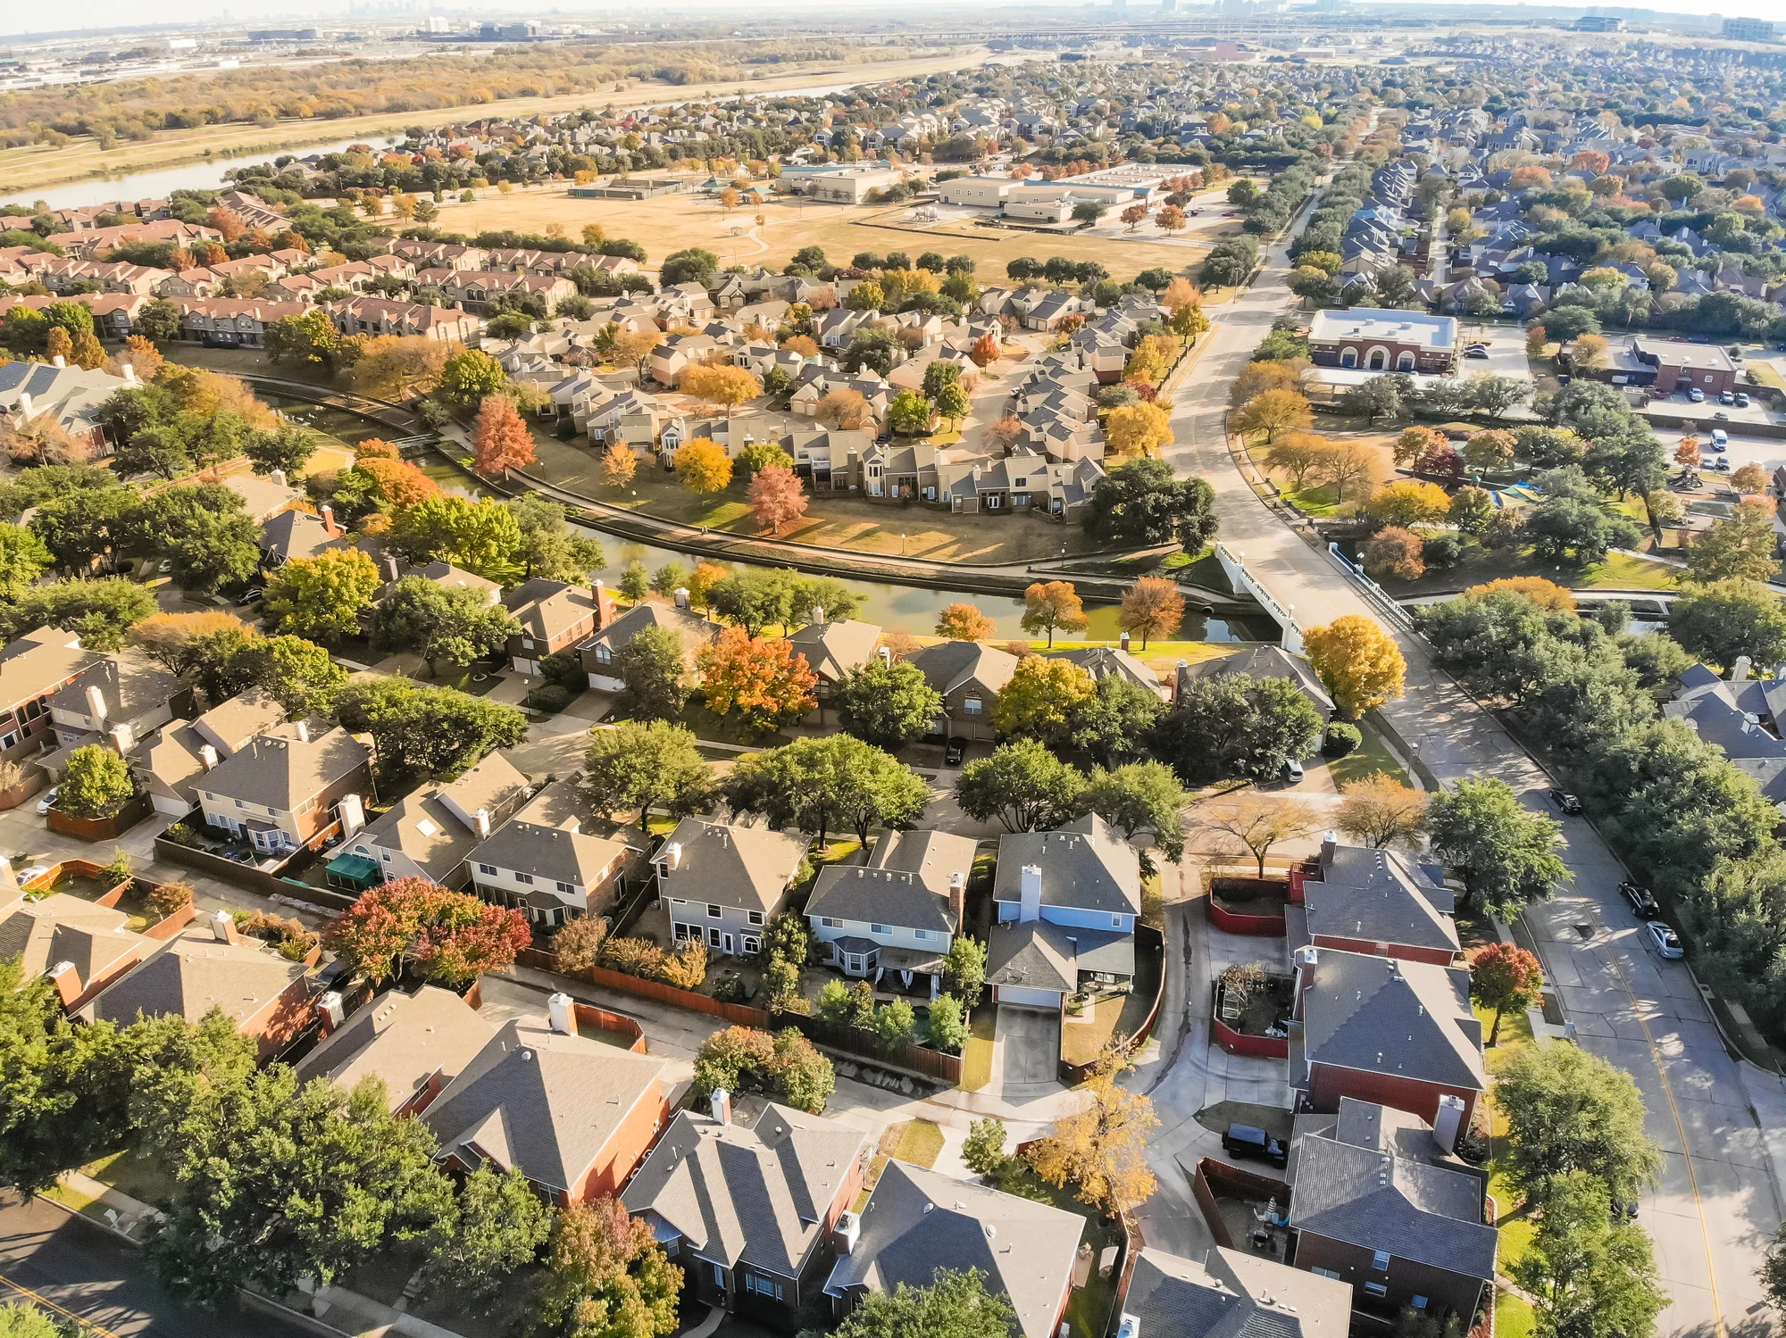
Ironhack Mid-Bootcamp Project: Housing Prices Regression
Presented by: Gabriel Valdes
Cohort: Rmt-PTDA-Oct2023
Date: 2/15/2024

Slide 2

The Problem
Given a set of data for houses sold in a particular area of the U.S., create a machine learning model that can accurately predict the price of those houses using certain features including:
Number of bedrooms and bathrooms,
Quality of the view from the house,
Square footage and more.

Slide 3
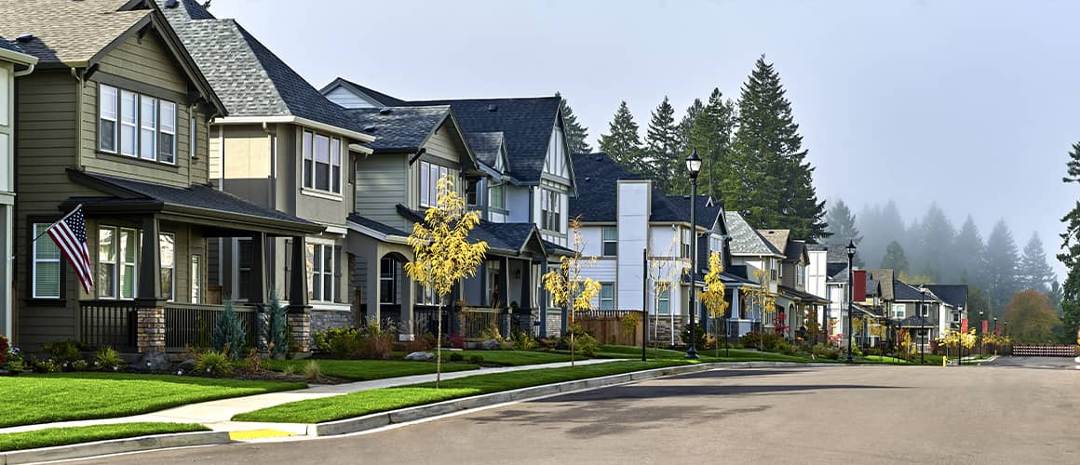
Observations About The Data (EDA)
First, I checked the shape and dtypes of the columns. There were no null values (great!)
I determined that our target column was ‘price,’ which was numerical and therefore I was going to be working toward building a linear regression model to start.
The data set did not contain any data that was obviously categorical in nature (strings). Every column contained numerical values.
There were many direct relationship with certain data and the target
For example: more bedrooms and/or bathrooms, larger square footage, better views and better condition = higher price.
Some data also seemed logically redundant
Condition : grade, view : waterfront, square footage metrics (above vs living vs lot), for example.

Slide 4

Feature Extraction & Data Cleaning
Features with many unique values like ‘zipcode’, ‘lat’, ‘long’ and ‘id’ were dropped, then categorical and numerical were separated
Categoricals were worked on first and I created a function to show me value counts of each column along with a subplot of the bar plot (showing each category’s significance vs. the target) and count plot
Numericals
'sqft_living',
'sqft_lot',
'sqft_above',
'sqft_basement',
'sqft_living15',
'sqft_lot15',
'price'
Categoricals
'bedrooms', | 'waterfront',
'bathrooms', | 'condition',
'floors', | 'yr_renovated',
'view', | 'yr_built'
'grade', | 'year_sold',
'zipcode',
Notes:
I tried to use Regex expression to create the numericals DF by finding all the columns in the original DF that began with ‘sqft_’ but it didn’t work

Slide 5
More Extraction and Cleaning (Categoricals)
My main goal when working with categorical columns was to create binary groupings, especially with those columns that I created from any data extraction. In my view this would make the encoding easier later
Examples: (1) I added a new binary column for ‘attic’ and took floors that ended with 0.5 decimal, removed it and added 1 (for yes) to it. (2) For me it was more important to know whether the house was renovated rather than knowing “Year Renovated”.
When creating binary categorical fields were not an option, I opted for reducing the number of categories where possible.
Examples: (1) I used pd.cut to make 4 major groups for the ‘yr_built’ column. (2) I extracted the partial bathrooms into their own column and left the whole numbers.
I reused my same function to display the subplots and value counts after I finished cleaning these columns to make sure I was satisfied with the direction I was heading
Notes:
bedrooms: create groupings of '1-3' & '4+’
and helped to fix any data imbalance within columns like ‘view’ where 90% of records were a single value.
View and grade grouped into binary
observation: older homes (pre-1950) and newer homes (after 1997) are more valuable.

Slide 6
More Extraction and Cleaning (Numericals)
Basement (Y/N) extracted from “sqft_basement” column
Created heatmap to check multicollinearity between the numerical features
Checked for distribution and outliers using sns.displot and boxplot subplots within a function
Many of the columns displayed major skewness and very long tails
Log transformation helped normalize the distributions
I created a “for-loop” to iterate on each column to simultaneously add new copies of columns with the log transformation applied.
Notes:
sqft_basement was the only column with 0 value records so I thought better to extract data from and then drop it.

Slide 7

Pre-Processing and Modeling
Utilized OneHotEncoder on the categorical data and the Standard Scaler, then concatenated the two feature DFs.
I knew that I wanted to use KNN as one of the models, so I used a RMSE vs. complexity graph to determine what the value of K should be.
Then, created a function that allowed me to fit and run each of my models:
Linear Regressor, K-Nearest Neighbor and MLP (Multi-layer Perceptron) Regressor
Notes:
Before scaling, I removed the target from the numerical DF

Slide 8
Results
ScalerUsed --> | MinMaxScaler |  |  | StandardScaler |  |  | NormalScaler
Accuracy Measure --> | R2 Score | RMSE Score | MAE Score | R2 Score | RMSE Score | MAE Score | R2 Score | RMSE Score | MAE Score
Linear Regression | 0.6060 | 0.3275 | 0.2617 | 0.6060 | 0.3275 | 0.2617 | 0.5118 | 0.3645 | 0.2909
K-Neighbors Regressor | 0.5757 | 0.3398 | 0.2675 | 0.6297 | 0.3175 | 0.2519 | 0.5284 | 0.3583 | 0.2827
MLP Regressor | 0.6430 | 0.3117 | 0.2455 | 0.6416 | 0.3123 | 0.2458 | 0.5198 | 0.3615 | 0.2872

Slide 9
Testing Assumptions
Homoscedasticity check showed no clear pattern in the distribution
Normality of errors: The residuals were approximately normally distributed.
Things I’d do differently the next time to achieve a better result:
Try to use frequency or mean encoding for zipcode
The code could have been more efficient with a function at the end when using the different scalers
I don’t believe I checked if K-value for KNN would be different depending on the scaler used.
Notes:
If there was a discernable pattern to the Homoscedasticity graph, then my results (though not particularly great) would not be reliable

Slide 10
Thank you !
Presented by: Gabriel Valdes
Cohort: Rmt-PTDA-Oct2023
Date: 2/15/2024

